Slide 1
Eating Healthy
Becca Chase
Early Elementary School Health

Slide 2
Discussion questions
What are the everyday foods?
What are the sometimes foods? Why are these sometimes foods?
What types of foods do our bodies need most and least?
Why do you think our bodies need a balance of difference foods?
What do you think would happen if we didn’t eat these foods and only ate the sometimes foods?

Slide 3
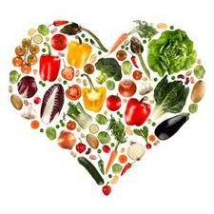
Reasons to eat healthier
You will have more energy
Your body will be better nourished
You will be less prone to sicknesses
You will think more clearly
You are less likely to get “tummy aches”
You will be a healthy adult
You will develop good eating habits
You will feel GREAT!
Others?

Slide 4
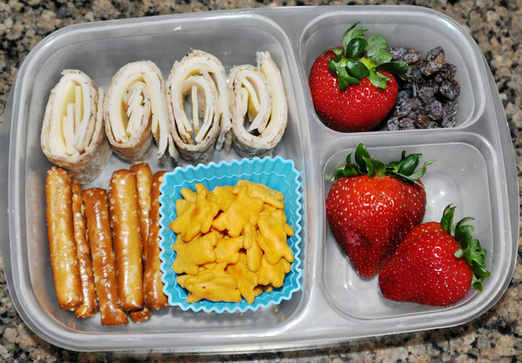
Pack a healthy lunch

Slide 5
Healthy Lunch
Pack a healthier lunch to eat while at school
Healthy lunches can be delicious and fun
Students who eat more nutritious lunches do better in the classroom
Check out this site for yummy, healthy lunch ideas: http://easylunchboxes.smugmug.com/The-Best-Lunchbox-System/Yummy-Lunch-Ideas/10136835_YSuyb#!i=696914291&k=YxmUd

Slide 6
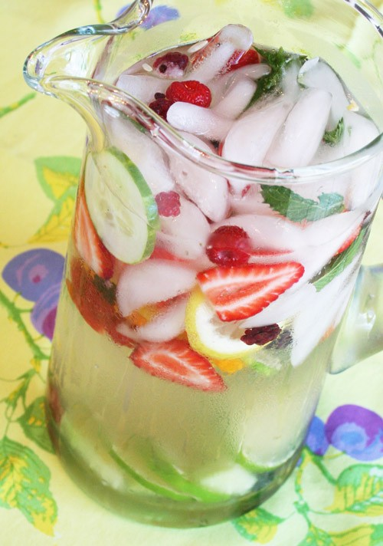
*TIP: Drink Water
Swap out soda and sugary drinks for water. Add fruit and veggies to make it extra tasty and refreshing. This will keep you hydrated and cleanse your system.

Slide 7
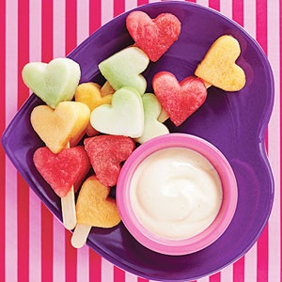
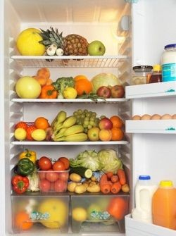
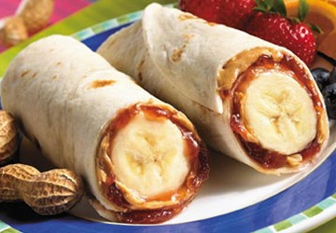
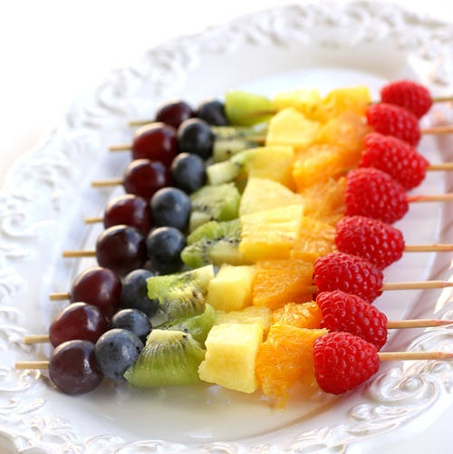
After School snacks
Snack on some healthy foods after school
Focus on getting a serving or fruit or vegetables in every snack
Get creative, healthy food can be fun too!

Slide 8
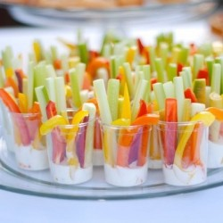
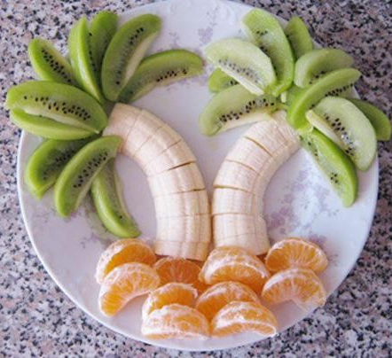
Make food fun
Veggie cups!
Fruit paradise!

Slide 9
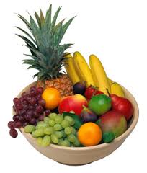

Slide 10
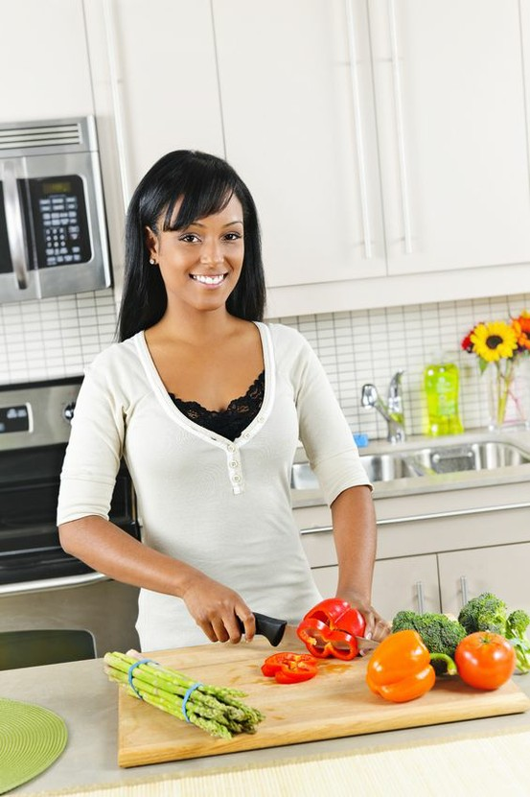
Help out in the kitchen
Help prepare healthy meals for dinner. Your parents will appreciate it, plus you can influence your family to eat better as a whole!

Slide 11
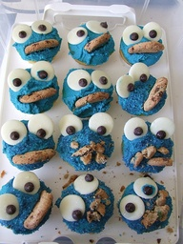
Junk Food
Junk food can make you feel sick and tired after consuming it
Junk foods to especially avoid eating on a regular basis are fast food and sweets
You can still eat your favorite junk foods every once in awhile, just do so in moderation (about once a week)

Slide 12
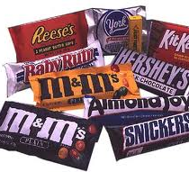
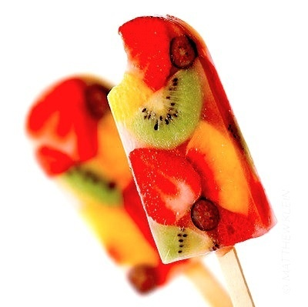
Dessert Swaps
Don’t: Candy
Do: Homemade popsicle

Slide 13
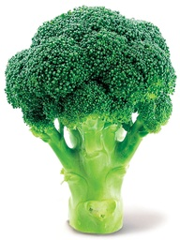
Las Vegas Restaurants To Try
Pizza Fusion
Fresh Mama
Whole Foods
Red Velvet Café
Sweet Tomatoes
Greens and Proteins
Veggie House
Jimmy John’s
Mint
Pure Vida

Slide 14
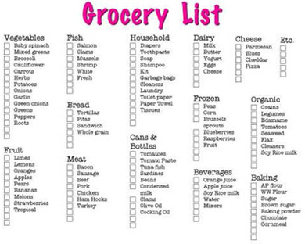
Lesson Plan Idea
Have students create dream grocery list or healthy ingredients. Use internet to research recipes, ingredients, and form list.

Slide 15
Work Cited
http://kidshealth.org/kid/stay_healthy/eat_pro/gonzalez.html#cat20693
www.pinterest.com
http://easylunchboxes.smugmug.com/The-Best-Lunchbox-System/Yummy-Lunch-Ideas/10136835_YSuyb#!i=696914291&k=YxmUd
http://greensandproteins.com/
http://concept-to-object.blogspot.com/2011/01/grocery-lists.html
http://www.goodforkids.nsw.gov.au/Partners/Primary_Schools/Healthy_Eating/Lesson_plans_and_curriculum

